Slide 1
266 Natural Language Processing
Week 8: Linguistic Representation

Slide 2
This Week
Goals
Understand how we can represent roles and relations between words
Understand how we can build graphs to represent language

Slide 3
Peeking Ahead
Week 1: Introduction
Week 2: Text Classification
Week 3: Language and Context
Week 4: Pretrained Transformers
Week 5: Text Generation Models
Week 6: Machine Translation
Week 7: Question Answering & Summarization
Week 8: Linguistic Representation
Week 9: Entities and Linking
Week 10: Embedding-based Retrieval
Week 11: Multimodality in NLP
Week 12: ML Fairness and Privacy
Week 13: NLP in the Real World PROJECT DUE Apr. 14

Slide 4
Announcements
Assignment 3 (Various) - released this past Friday 2/16
  Due on Sunday 3/3 (Tuesday 3/5 if you use late days)
Assignment 4 (MM) to be released Friday 3/8
  Final assignment
Project Proposals - Past Due (02/18)!
  Feedback complete
  Questions?
Concerns?

Slide 5
Announcements
Paper reading sessions:
  Songs Across Borders: Singable and Controllable Neural Lyric Translation
    Natalie: Wednesday 02/28 5:30 PST
  WebGLM: Towards An Efficient Web-Enhanced Question Answering System with Human Preferences
    Jennifer: Monday 03/04 5:30 PST
Notebook walkthrough sessions:
  TBD
Concerns?

Slide 6
The Plan
Structure of Class
Elements of Language
Parsers and Parsing
  Transition Parsing
  Chart Parsing
  Neural Constituency Parsing
Evaluation
Soft Prompt Tuning

Slide 7
Elements of Language
Linguistic Representation

Slide 8
Elements of Language
Language is more than just words.
Brainstorm:
When we use a “bag of words” model what are we losing from the representation?
We’ve used embeddings to represent words (in context?). How can we represent other elements of language?

Slide 9
Elements of Language
Words play roles in a sentence:
What role do nouns play?
What role do verbs play?
Part of Speech (POS) tags denote the roles words play in a sentence
DT
NN
VBZ
JJ
NN
PUNC
The
decoder
generates
fluid
language
.

Slide 10
Elements of Language
Spans represent natural sequences of words.
DT
NN
VBZ
JJ
NN
PUNC
The
decoder
generates
fluid
language
.
What kinds of linguistic elements are spans?
How can we represent spans in a neural model?

Slide 11
Elements of Language
Graphs or Trees represent relations between words and spans.
Linguistic theories can help determine the shape of a graph by specifying relations or labels.
What are some relations between words or nodes?
What do we call a set of rules or constraints that structure a tree?
The
decoder
generates
fluid
language

Slide 12
Elements of Language
S -> NP VP
NP -> JJ NN
NP -> DT NN
VP -> VBZ NP
DT -> ‘The’
NN -> ‘decoder’|’language’
JJ -> ‘fluid’
VBZ -> ‘generates’
Grammars:
Constrain how words can be assembled
Productions have a LHS and RHS
Terminals are words in lexicon
Non-terminals are groupings
Context Free Grammars
Terminals rules can be applied regardless of context
Probabilistic Context Free Grammars
Probability for each rule
Notes:
Tom ran up the hill

Slide 13
Elements of Language
S
VP
NP
NP
DT
NN
VBZ
JJ
NN
The
decoder
generates
fluid
language
Constituency Trees group words and phrases into subtrees and a tree.
Grammars can describe how these subtrees are assembled.

Slide 14
Elements of Language
Can I recover phrases from a dependency tree?
ROOT
dobj
det
nsubj
amod
DT
NN
VBZ
JJ
NN
PUNC
The
decoder
generates
fluid
language
.
Dependency Trees describe typed relations between individual words.
Each word has one incoming branch.
ROOT is the artificial top of the tree.

Slide 15
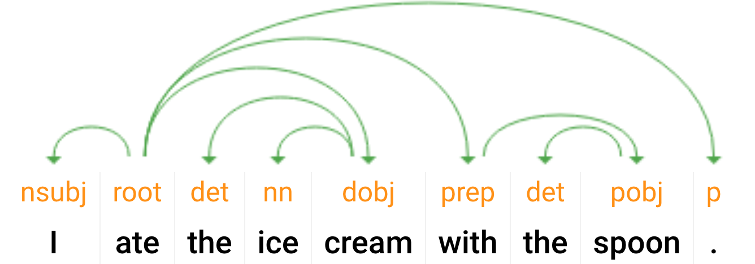
Parsing Challenge!
What’s the goal?
I ate the ice_cream with the spoon.
I ate the ice_cream with the cherry.
Notes:
Identical POS tags but different trees due to prepositional attachment. Also: “Pasta: With chopsticks vs. with sauce”

Slide 16
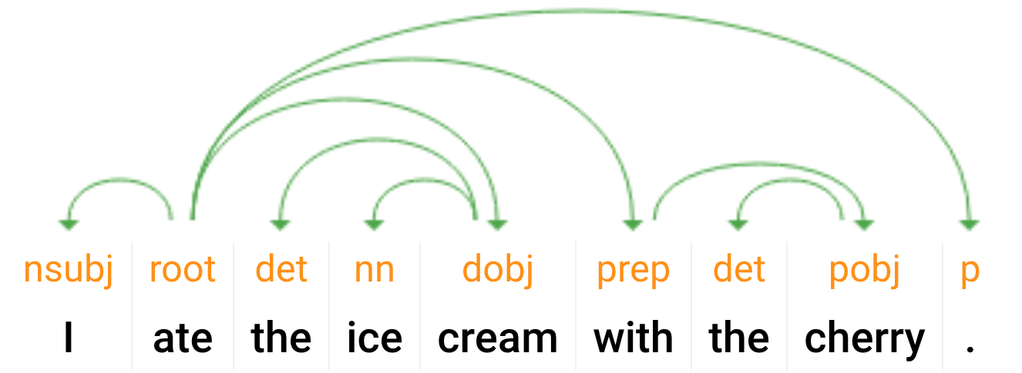
Parsing Challenge!
What’s the goal?
I ate the ice_cream with the spoon.
I ate the ice_cream with the cherry.
Notes:
Identical POS tags but different trees due to prepositional attachment. Also: “Pasta: With chopsticks vs. with sauce”

Slide 17
Parsers and Parsing Approaches
Linguistic Representation

Slide 18
Use BERT to train a POS tagging model
DT
NN
VBZ
JJ
NN
PUNC
BERT
The
decoder
generates
fluid
language
.

Slide 19
Parsing Approaches: Overview
Parsing task: tree-structured prediction of language
Types of parsing | Parsing techniques/algorithms
Dependency | Transition-based
Constituency/phrase-structure | Graph-based
(Semantic) | Chart-based
Similar goal: find the best tree; different formalisms, but similar algorithms used for all types
Notes:
Also top-down vs. bottom-up. We’ll mostly consider bottom-up in this class, but top-down algorithms are similar.

Slide 20
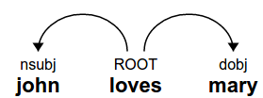
Transition-Based Parsing
Mechanism: build parse tree by sequence of actions (transitions)
Set-up (state)
  A buffer initialized with the words
  A stack to store state
    Words under consideration for more edges
  Dependency arcs (edges)
    The partially constructed tree
ROOT
The
model
generates
fluid
text
Stack
Buffer
Notes:
Related to algorithms for parsing deterministic grammars such as programming languages (e.g. LALR parsers). More generally, any context-free grammar can be parsed using a transition system.

Slide 21
Transition-Based Parsing
Mechanism: build parse tree by sequence of actions (transitions)
Arc-standard parsing
  Shift: consume from buffer, push to stack
  Left-arc: add left edge, remove from stack.
  Right-arc: add right edge, remove from stack.
ROOT
The
model
generates
fluid
text
Stack
Buffer

Slide 22
Arc-Standard Parsing Example
Transitions
Shift
Arc-standard parsing
Shift: Consume from buffer, push to stack.
Left-arc: Add left edge, remove from stack.
Right-arc: Add right edge, remove from stack.
ROOT
The
model
generates
fluid
text
Stack
Buffer

Slide 23
Arc-Standard Parsing Example
Transitions
Shift
Shift
Arc-standard parsing
Shift: Consume from buffer, push to stack.
Left-arc: Add left edge, remove from stack.
Right-arc: Add right edge, remove from stack.
ROOT
The
model
generates
fluid
text
Stack
Buffer

Slide 24
Arc-Standard Parsing Example
Transitions
Shift
Shift
Left-arc
Arc-standard parsing
Shift: Consume from buffer, push to stack.
Left-arc: Add left edge, remove from stack.
Right-arc: Add right edge, remove from stack.
det
ROOT
model
generates
fluid
text
The
Stack
Buffer

Slide 25
Arc-Standard Parsing Example
Transitions
Shift
Shift
Left-arc
Shift
Arc-standard parsing
Shift: Consume from buffer, push to stack.
Left-arc: Add left edge, remove from stack.
Right-arc: Add right edge, remove from stack.
det
ROOT
model
generates
fluid
text
The
Stack
Buffer

Slide 26
Arc-Standard Parsing Example
Transitions
Shift
Shift
Left-arc
Shift
Left-arc
Arc-standard parsing
Shift: Consume from buffer, push to stack.
Left-arc: Add left edge, remove from stack.
Right-arc: Add right edge, remove from stack.
nsubj
det
ROOT
generates
fluid
text
model
Stack
The
‘The’ and ‘model’ are now off the stack.
Buffer

Slide 27
Arc-Standard Parsing Example
Transitions
Shift
Shift
Left-arc
Shift
Left-arc
Shift
Arc-standard parsing
Shift: Consume from buffer, push to stack.
Left-arc: Add left edge, remove from stack.
Right-arc: Add right edge, remove from stack.
nsubj
det
ROOT
generates
fluid
text
model
Stack
The
Buffer

Slide 28
Arc-Standard Parsing Example
Transitions
Shift
Shift
Left-arc
Shift
Left-arc
Shift
Shift
Arc-standard parsing
Shift: Consume from buffer, push to stack.
Left-arc: Add left edge, remove from stack.
Right-arc: Add right edge, remove from stack.
nsubj
det
ROOT
generates
fluid
text
model
Stack
The
Buffer

Slide 29
Arc-Standard Parsing Example
Transitions
Shift
Shift
Left-arc
Shift
Left-arc
Shift
Shift
Left-arc
Arc-standard parsing
Shift: Consume from buffer, push to stack.
Left-arc: Add left edge, remove from stack.
Right-arc: Add right edge, remove from stack.
nsubj
amod
det
generates
text
ROOT
model
The
fluid
Stack
Buffer

Slide 30
Arc-Standard Parsing Example
Transitions
Shift
Shift
Left-arc
Shift
Left-arc
Shift
Shift
Left-arc
Right-arc
Arc-standard parsing
Shift: Consume from buffer, push to stack.
Left-arc: Add left edge, remove from stack.
Right-arc: Add right edge, remove from stack.
nsubj
obj
det
amod
generates
ROOT
text
model
The
fluid
Stack
Buffer

Slide 31
Arc-Standard Parsing Example
Transitions
Shift
Shift
Left-arc
Shift
Left-arc
Shift
Shift
Left-arc
Right-arc
ROOT
Arc-standard parsing
Shift: Consume from buffer, push to stack.
Left-arc: Add left edge, remove from stack.
Right-arc: Add right edge, remove from stack.
ROOT
nsubj
obj
det
amod
generates
model
text
The
fluid
Stack
Buffer

Slide 32
Arc-Standard Parsing Example
ROOT
Transitions
Shift
Shift
Left-arc
Shift
Left-arc
Shift
Shift
Left-arc
Right-arc
ROOT
dobj
det
nsubj
amod
DT
NN
VBZ
JJ
NN
The
model
generates
fluid
text
The resulting dependency tree and transition sequence.

Slide 33
Transition-Based Parsing: Analysis
Why “shift-reduce” parsing
  Shift: (shift) move from buffer to stack
  Reduce: (left-arc, right-arc) add edges, and remove elements from stack
For N tokens
  O(N) shift operations (one for each token)
  O(N) reduce operations (one for each edge)
O(N): linear time parsing! (if you can choose the right transitions)

Slide 34
How to Choose Transitions
Multi-class prediction
Inputs: state = {stack, buffer, other features}
Targets: transitions = {shift, left-arc, right-arc}
Classifier/Oracle:
score(a_{i} | state_{i}) at step i
  Rule-based, SVM, NN, etc.
Training
  Predict “gold” actions (from true tree)
  Or “dynamic oracle” rewards good actions
score(Shift)
score(Left-Arc)
score(Right-Arc)
h2
h1
Stack features
Buffer features
ROOT
John
loves
Mary
.
Stack
Buffer

Slide 35
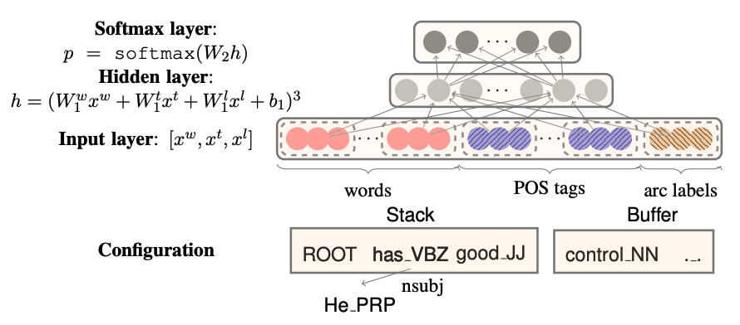
Neural Transition Parser
Use embeddings of words, POS tags, and Arc labels in stack and buffer to predict transition label
Recipe
  Represent “configuration” of buffer and stack using concatenated embeddings
  Embeddings for words as well as specialized embeddings for POS and arc labels
  Softmax distributes probabilities over transition labels
Source: A Fast and Accurate Dependency Parser using Neural Networks

Slide 36
Parsing Approaches: Overview
Parsing task: tree-structured prediction of language
Types of parsing | Parsing techniques/algorithms
Dependency | Transition-based
Constituency/phrase-structure | Graph-based
(Semantic) | Chart-based
Similar goal: find the best tree; different formalisms, but similar algorithms used for all types
Notes:
Also top-down vs. bottom-up. We’ll mostly consider bottom-up in this class, but top-down algorithms are similar.

Slide 37
Chart-Based Parsing
The chart: dynamic programming table
  n(n+1)/2 cells
  Represent spans [i,j)
  Entries: subtree derivations
Example
(ROOT
(S
(NP (NNP James))
(VP (VBD ate)
(NP (DT the) (NN food)))))
How can we refer to the span for “the food”?
S
VP
NP
NP/ NNP
VBD
DT
NN
James
ate
the
food
0
1
2
3
4
Notes:
(1 + 2 + 3 + …. + n) = n(n+1)/2

Slide 38
Chart-Based Parsing (cont.)
CKY algorithm
  Variant of Viterbi decoding
    Assume binary tree and grammar.
    For each cell, consider L, R subtrees.
    Choose best (highest scoring) candidate.
    Store backpointers.
S
VP
NP
Is this an example of top down or bottom up parsing?
NP/ NNP
VBD
DT
NN
James
ate
the
food
0
1
2
3
4

Slide 39
Chart + CKY Algorithm
S → NP VP
NP → NNP
VP → VBD NP
NP → DT NN
NNP → “James”
VBD → “ate”
DT → “the”
NN → “food”
Token cells: [i, i+1) (assume have POS tags)
Store best score(i,j,X) for symbol X
For each cell [i,j), bottom-up:
  For each rule (A → B C):
    For each split i ﹤ ℓ < j:
    x = score(i,ℓ,B) + score(ℓ,j,C)
    + weight(A → B C)
    If x > score(i,j,A):
    score(i,j,A) = x
    children(i,j,A) = [(i,ℓ,B),
    (ℓ,j,C)]
S
VP
NP
NP/ NNP
VBD
DT
NN
James
ate
the
food
0
1
2
3
4

Slide 40

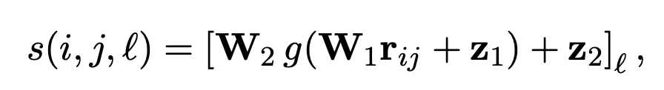
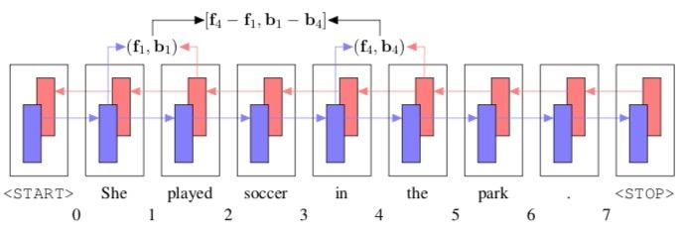
Span Representation
Are a grammar and POS tags a requirement for chart parsing?
Use bi-LSTM to generate ‘fenceposts’ and concatenate differences to represent the span
Learn to score and label the spans
Use the scored spans (like a grammar) to construct best tree based on scored subtrees
Source: What’s Going On in Neural Constituency Parsers? An Analysis

Slide 41
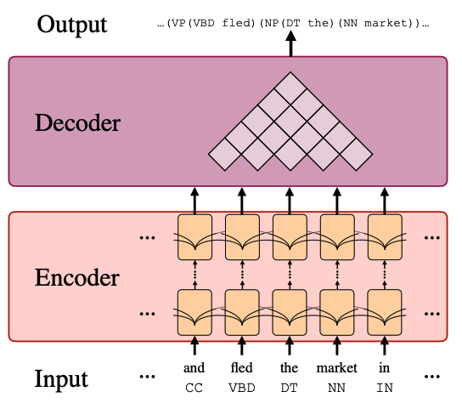
Neural Constituency Parser
Transformer: use transformer embeddings to identify and score spans for inclusion in chart parser-based decoder
Recipe
  Encoder gets word and POS tag embeddings
  No grammar input required
  Decoder assigns score to each span i,j with label l
  Chart-based output constituent tree is highest scoring tree
Source: Constituency Parsing with a Self-Attentive Encoder
Notes:
Use “translation” model to train. (really some seq2seq model)
X = “James ate the food”
Y = “(ROOT(S(NP (NNP James))(VP (VBD ate)(NP (DT the) (NN food)))))”
<or>
Y = tree structure, filled in

Slide 42
Parsing Evaluation
Linguistic Representation

Slide 43
Parsing Evaluation
Pars-eval
Compare candidate and reference constituency trees
Recall - how many of the constituents in reference tree are in the candidate tree
Precision - how many of the constituents in the candidate tree are in the reference tree
F1 = (2 * Precision * Recall)/(Precision + Recall)
Notes:
See Slide 39

Slide 44
Parsing Evaluation
UAS and LAS accuracy
Compare candidate and reference dependency trees
UAS - (unlabeled attachment score)
  Percentage of arcs in the candidate that are connected to the right node (ignore labels)
LAS - (labeled attachment score)
  Percentage of arcs in the candidate that are connected to the right node and correctly labeled
Notes:
See Slide 34

Slide 45
Notebook Walkthrough
Linguistic Representation

Slide 46
Paper Peeks/Recent Advances/Challenges
Linguistic Representation

Slide 47
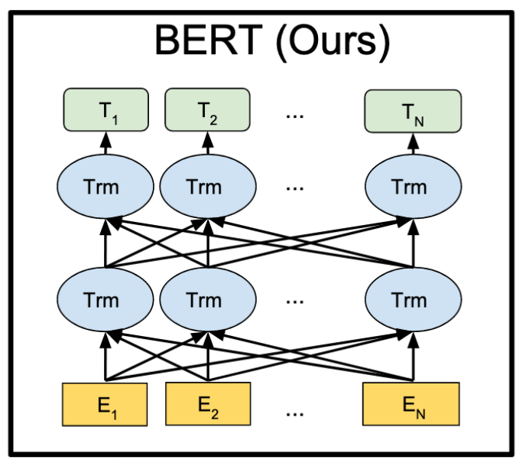
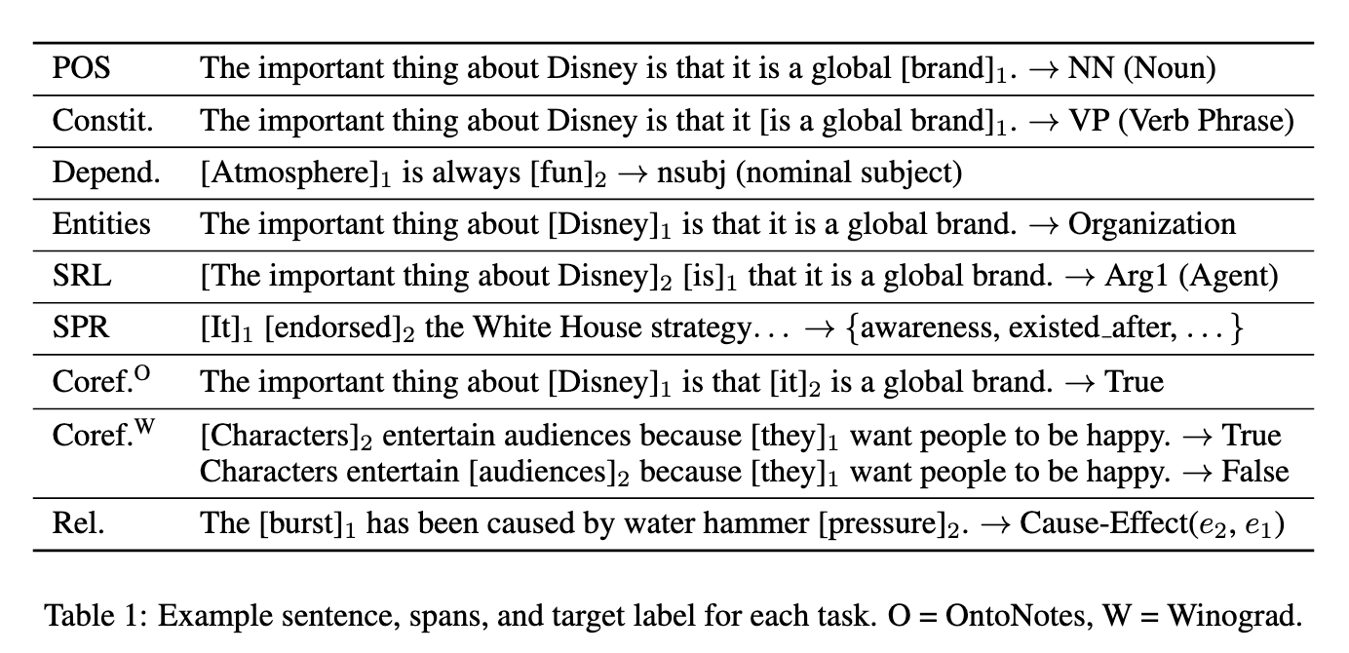
“Old” and “New” Approach to NLP Use Cases
“Old”: Build Models based on Classical “New”: Use BERT (& Similar)
NLP Pipeline
Source: Devlin et al
Source: “What Do You Learn from Context? Probing for Sentence Structure in Contextualized Word Representations” Tenney et al
Does BERT learn any relationships?
And what type of information is learned in which BERT layers?

Slide 48
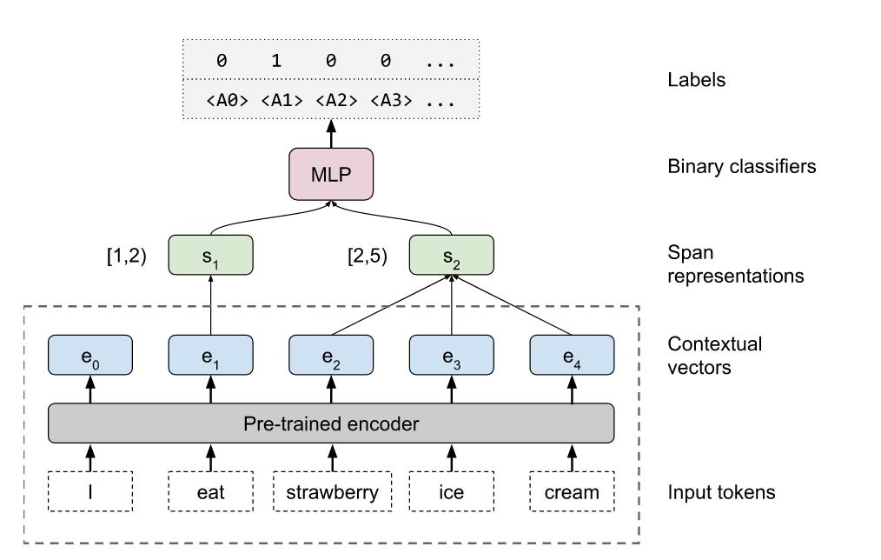
What Types of Sentence Features Are Learned?
“Edge-Probing” Architecture:
Learned weights for classification of span pair relation
Learned weights for span pair identification
Pre-trained encoder with fixed embeddings to be analyzed
Source: “What Do You Learn from Context? Probing for Sentence Structure in Contextualized Word Representations” Tenney et al

Slide 49
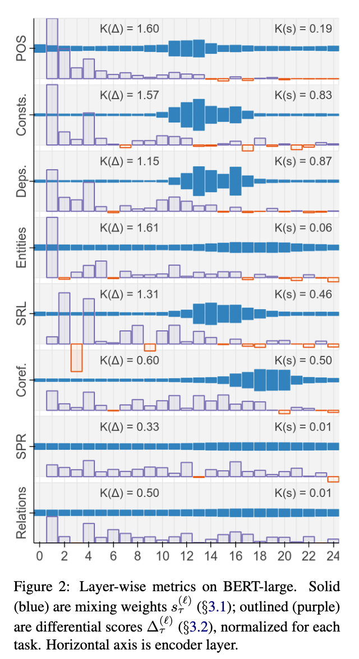
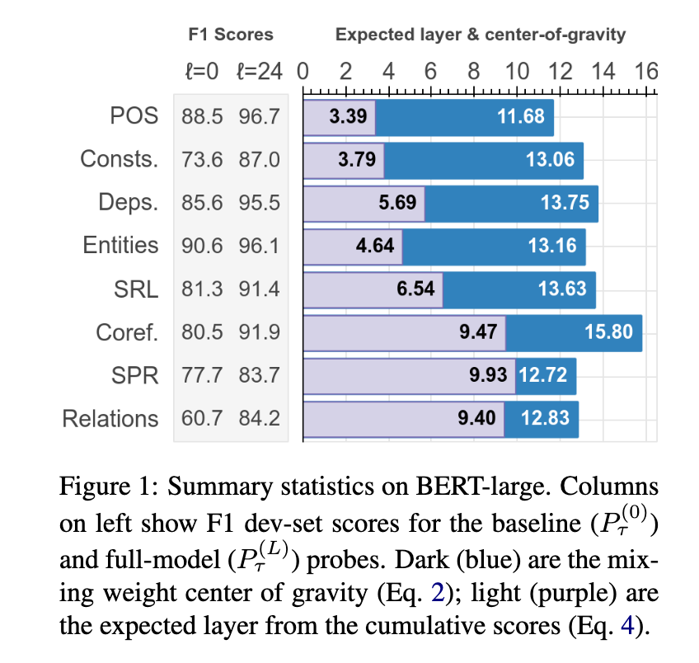
Contextual Embeddings & Sentence Structures
Main Take-Aways:
Context-based embed-
dings do learn about linguistic structures
POS comes “early”, more
complex aspects are
learned in later layers
“BERT Rediscovers the Classical NLP Pipeline”, I. Tenney et al, Google.
See details for metrics, etc.

Slide 50
Training: Domain Adaptation
Linguistic Representation

Slide 51
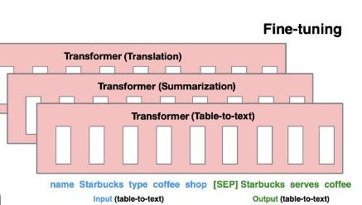
Prompt Tuning
Drawbacks of fine-tuning
  Modified parameters make unique model version
  Every task gets own model
  Rapidly consumes memory
Source: Prefix-Tuning: Optimizing Continuous Prompts for Generation

Slide 52
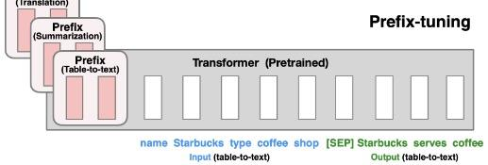
Prompt Tuning
Advantages of prefix prompts
  Use one frozen model version
  Every task gets own prefix vectors
  Steady small memory usage
Source: Prefix-Tuning: Optimizing Continuous Prompts for Generation
Notes:
“Sum_marize the follow_ing : “
Gets converted into a number of (dense) vectors .. the first 4-7 vectors that the model sees (depending on subwords)

Slide 53
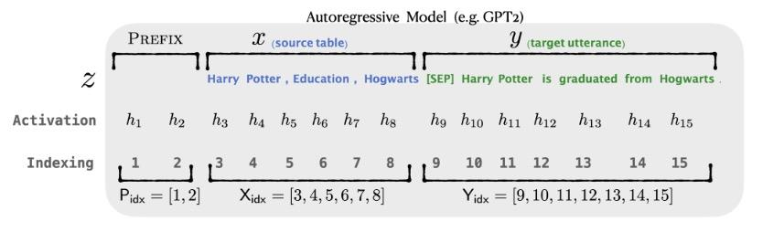
Prompt Tuning - GPT
Fine tune the prefix parameters only while keeping all other parameters in the model frozen.
Source: Prefix-Tuning: Optimizing Continuous Prompts for Generation

Slide 54
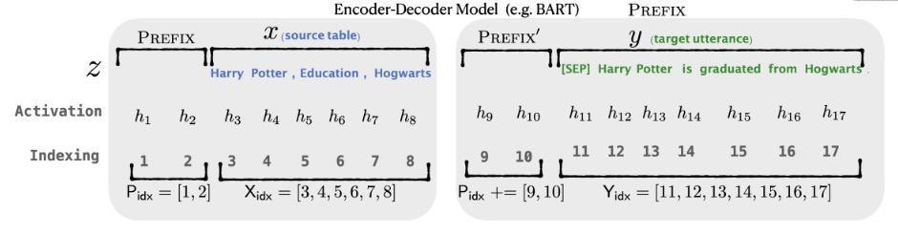
Prompt Tuning - Encoder/Decoder
Fine tune the prefix parameters in encoder and decoder only while keeping all other parameters in the model frozen.
Source: Prefix-Tuning: Optimizing Continuous Prompts for Generation

Slide 55
Extras
Linguistic Representation

Slide 56
Key Learnings Review
Linguistic Representation

Slide 57
NLP Review
What are the key differences between the GPT and the BERT models?
What characterizes the goal(s) of a few-shot model?
What are some language modeling corruption tasks (e.g. tasks used to create language models)?

